Slide 1
Fire Safety in HMO’s
WM Dave Baylay

Slide 3
Scope
Role of the Fire & Rescue Service (Inspectors)
Building Regulations
Fire Risk Assessment
Brief case study
Means of escape & fire doors
Maximising habitable spaces: Inner rooms, attic rooms
Management of fire safety

Slide 4
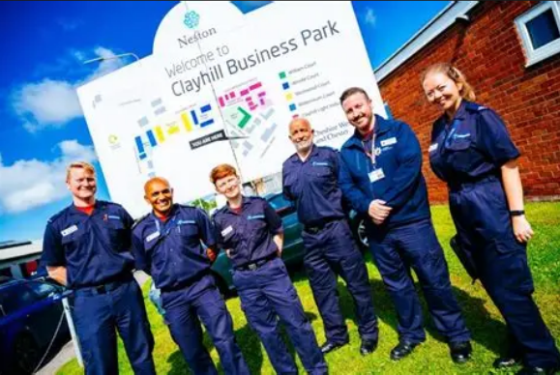
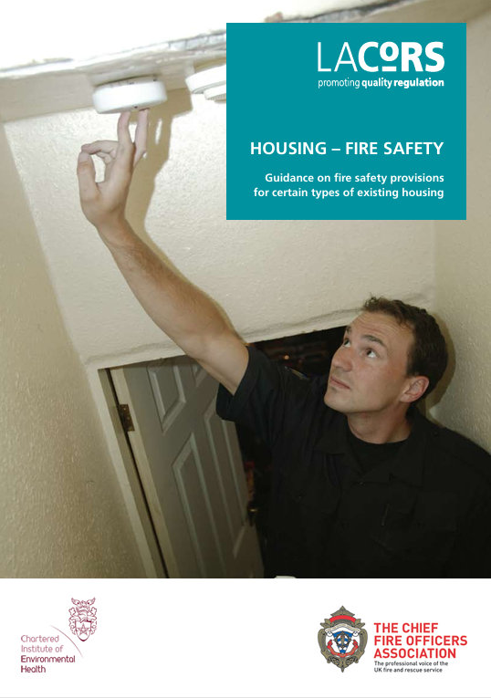
Role of the Fire & Rescue Service
(Inspectors)
Trained & Qualified inspectors
Statutory duty to inspect
Guidance based & Regulators Code

Slide 5
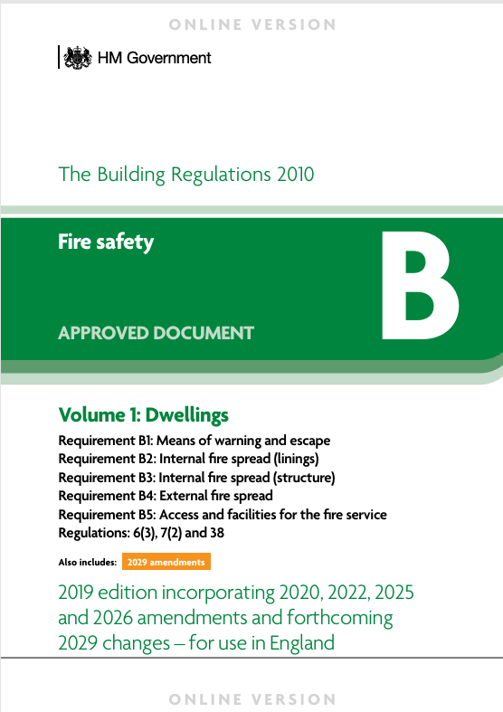
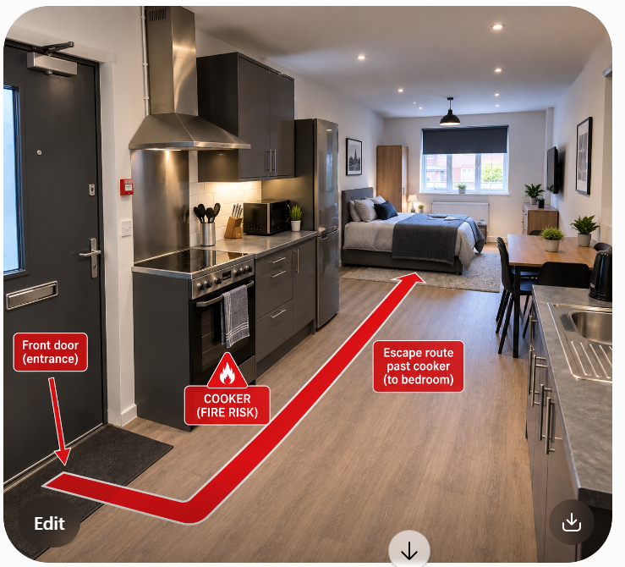
Building Regulations
Notes:
Works requiring B regs
Role of AI
FRS statutory consultee

Slide 6
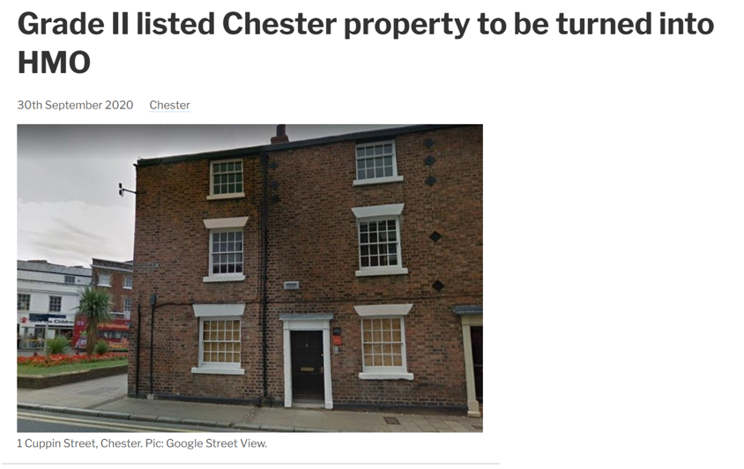
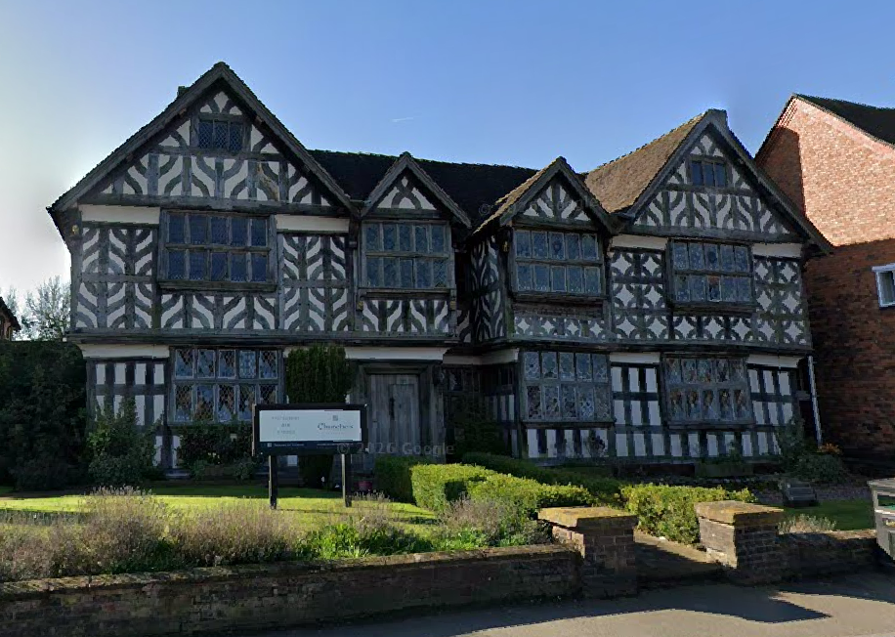
Listed heritage properties
Churches Mansion Nantwich
Notes:
Listed Building Consent
Inherently higher risk – construction & LBC limitations
Fire engineered solution – sprinklers, misting, smoke control

Slide 7
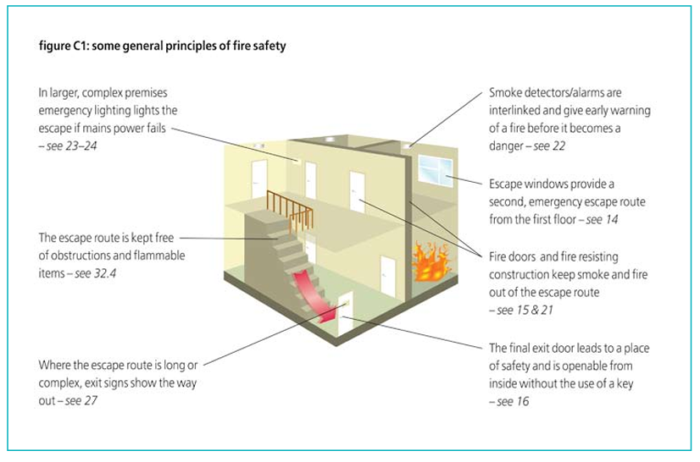
Fire safety principles
Notes:
Good fire safety – reasonable measures: EICR, housekeeping, not wedging doors, separation

Slide 8
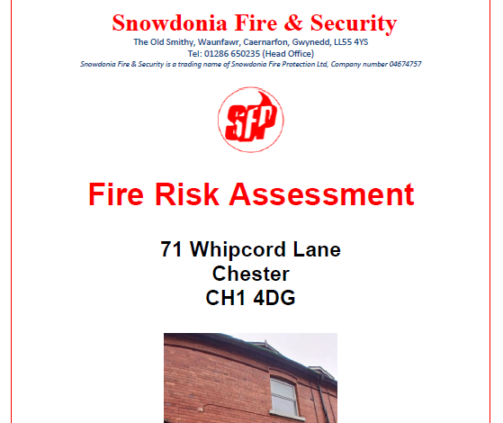
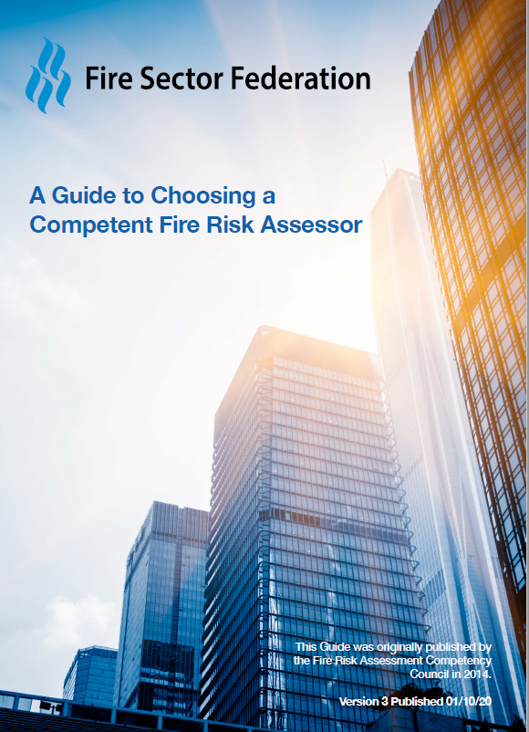
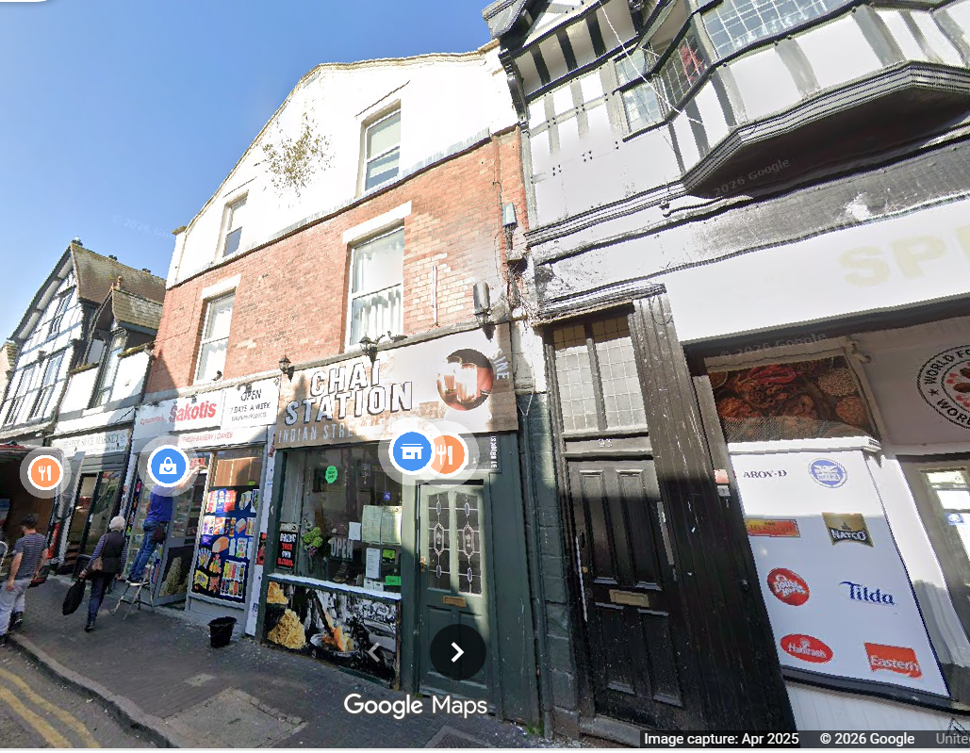
Fire Risk Assessment
Competent Assessor
‘Persons especially at risk’
Significant findings
Insurers requirement
Notes:
Tick boxy, PAS 79, overall risk determination, holistic look at the building, no of floors, construction, measures to reduce the, most importantly the occupancy

Slide 9
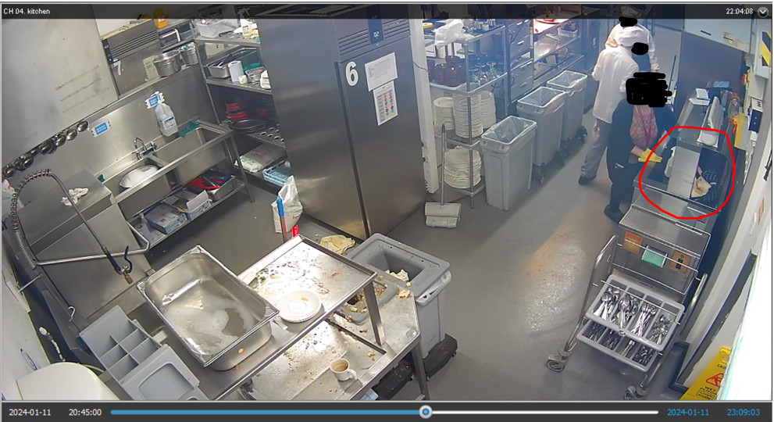
2309hrs
Notes:
Explain post fire investigation

Slide 10
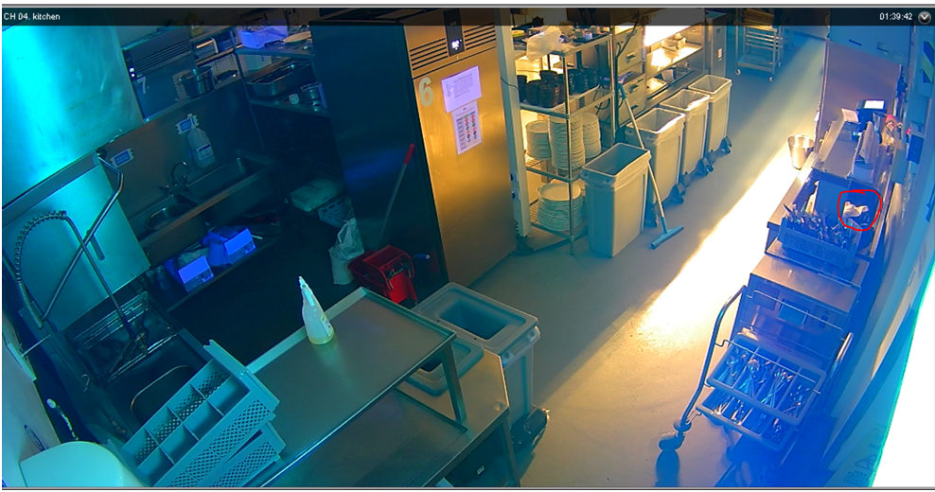
0139hrs – wisps of smoke

Slide 11
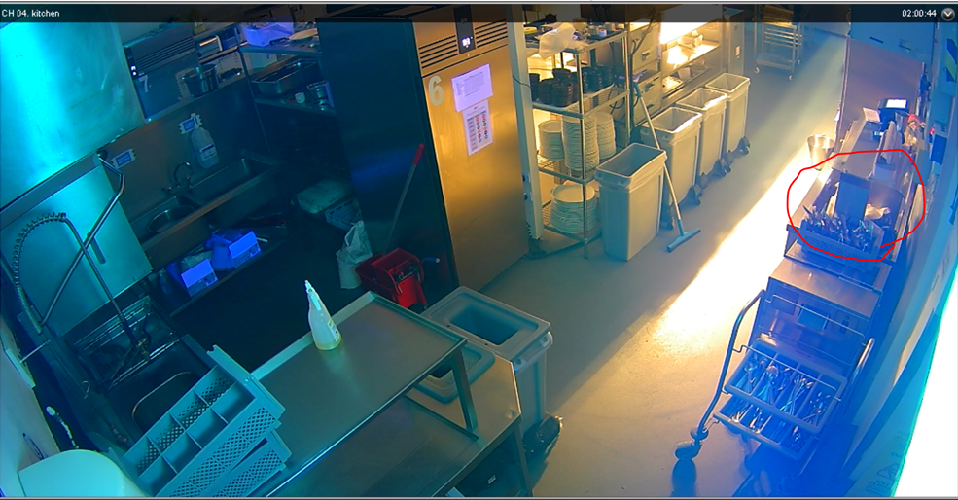
0200hrs –cloth smoking

Slide 12
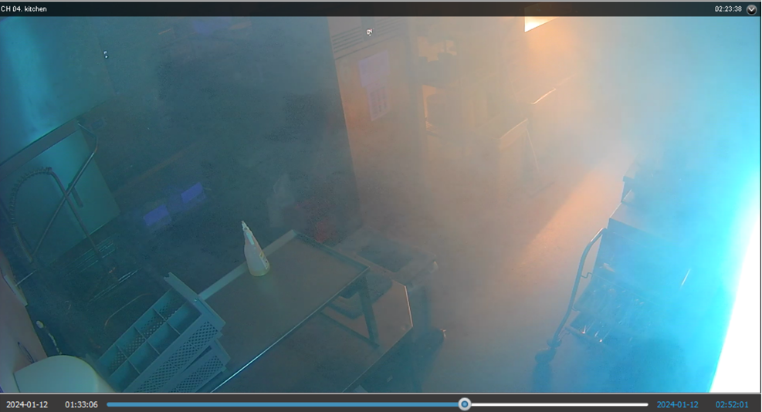
0223hrs – smoke logging

Slide 13
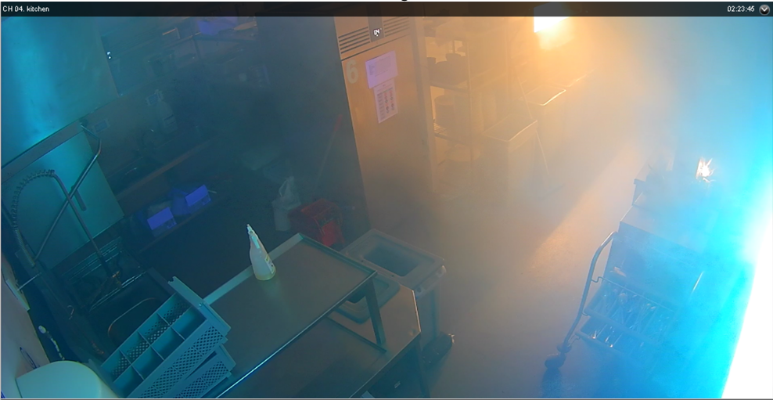
0223hrs - Ignition

Slide 14
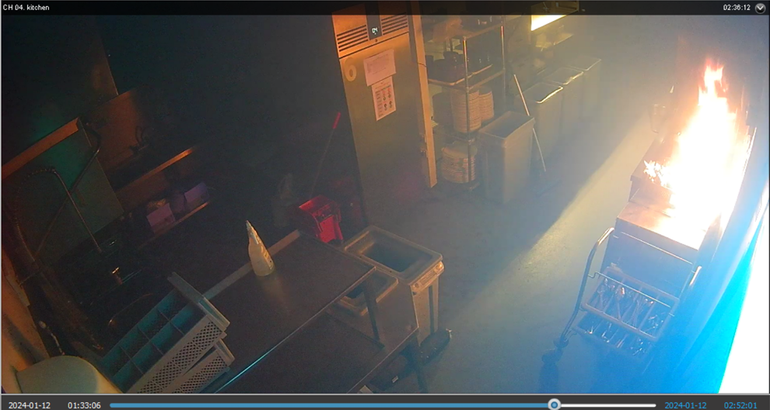
0236hrs – fire development

Slide 15
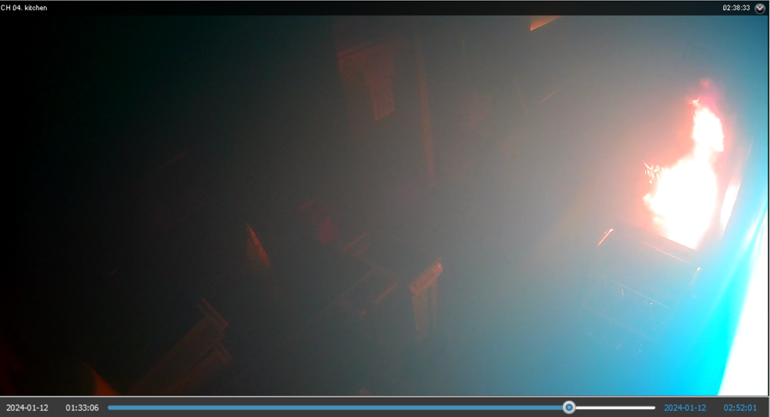
0252hrs

Slide 16
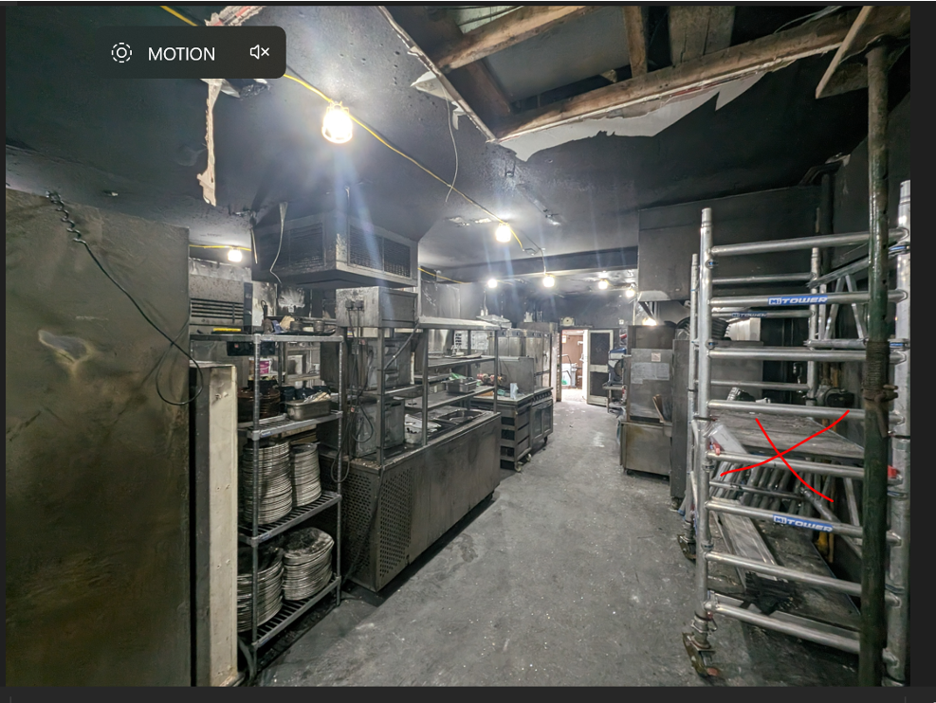

Slide 17
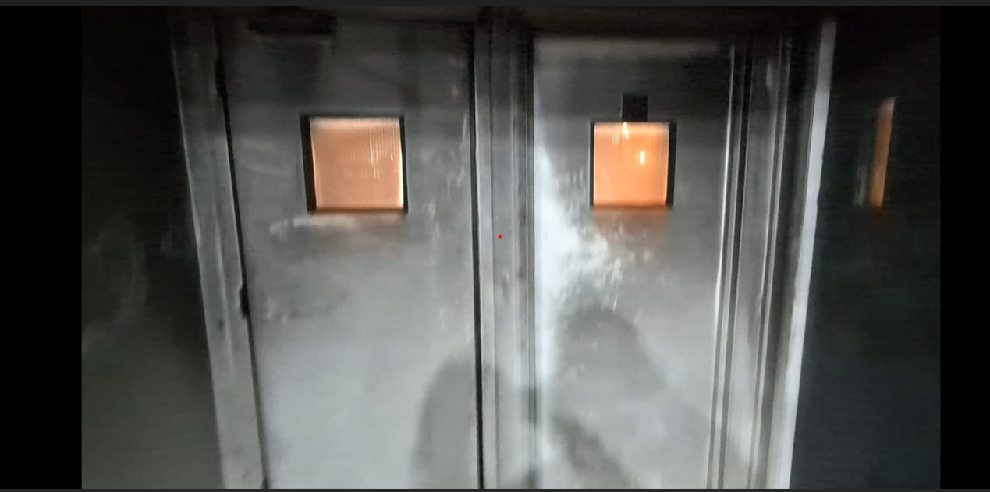

Slide 18
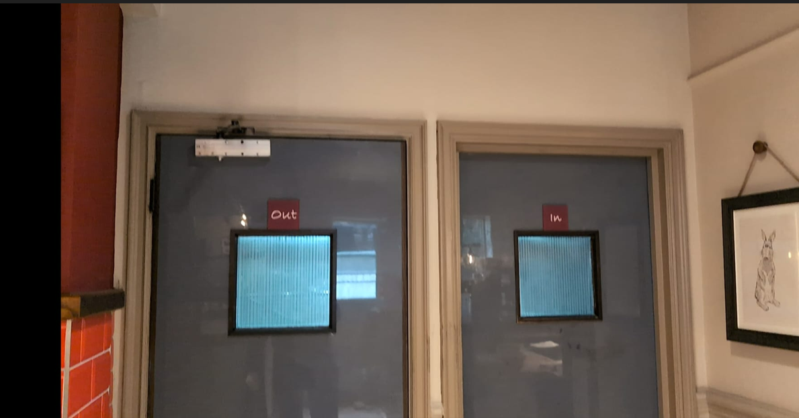

Slide 19
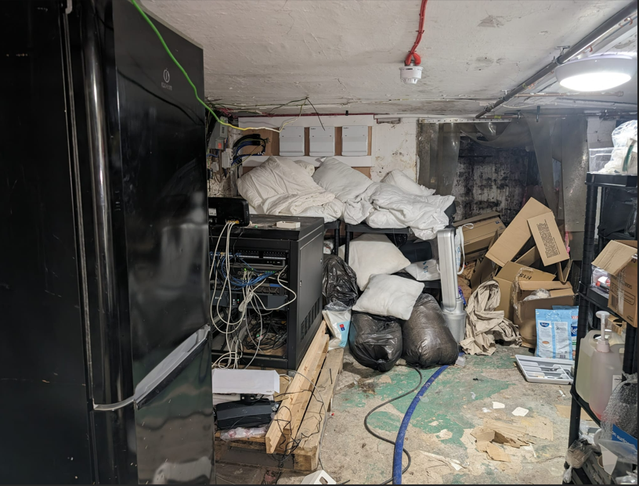
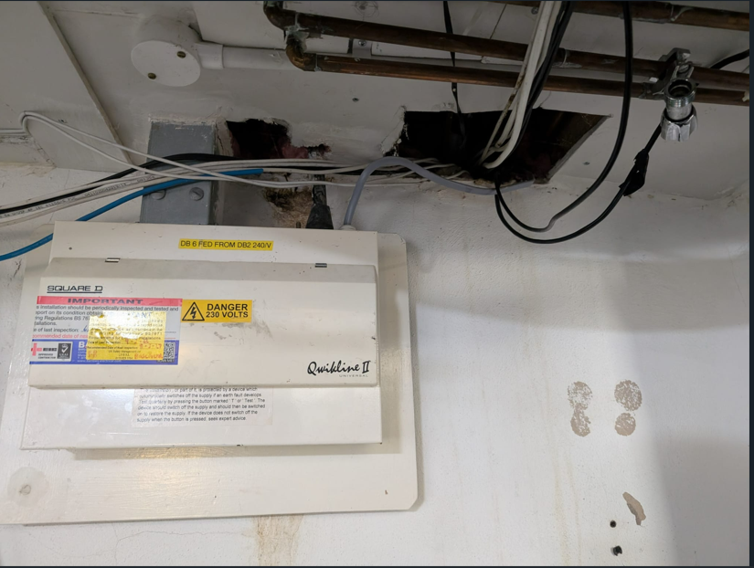
Basement high fire load & compartmentation

Slide 20
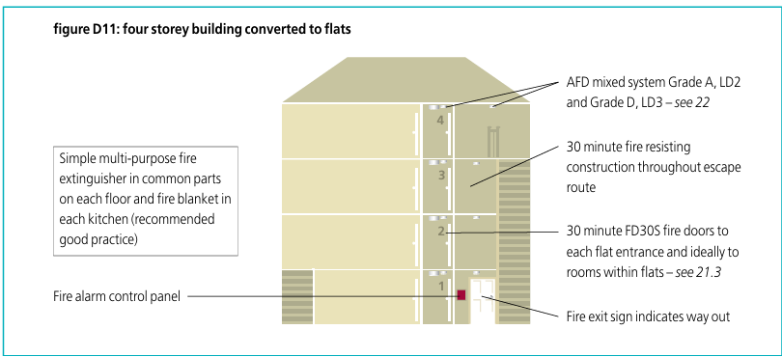
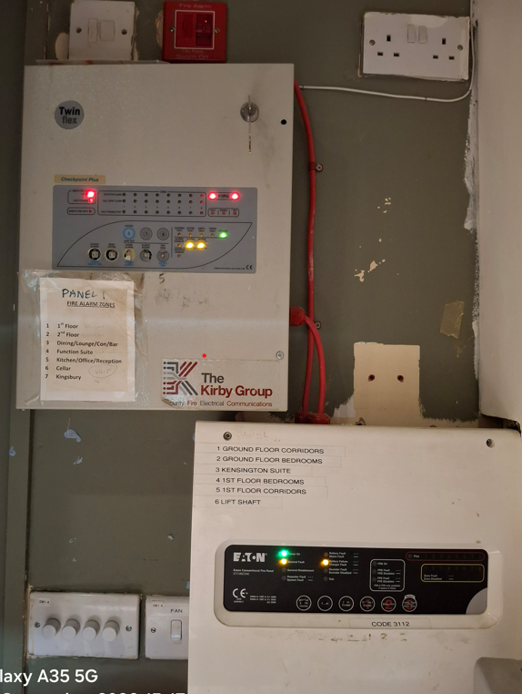
Fire Detection & Warning
Escape routes
Bedrooms
Kitchens – Heat/smoke
Basements

Slide 21
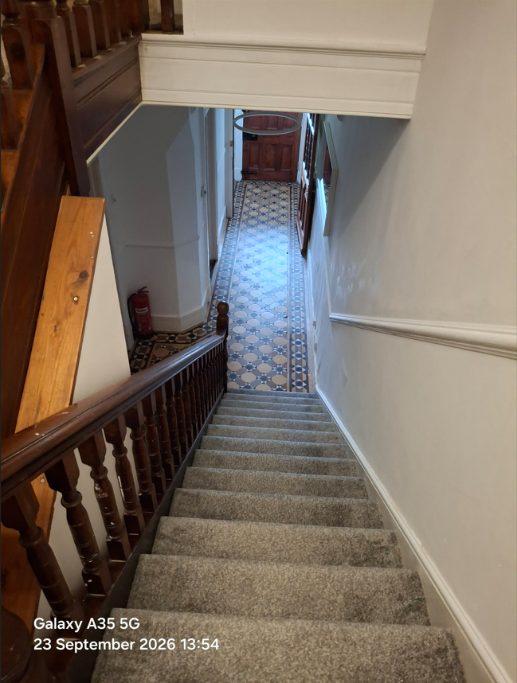
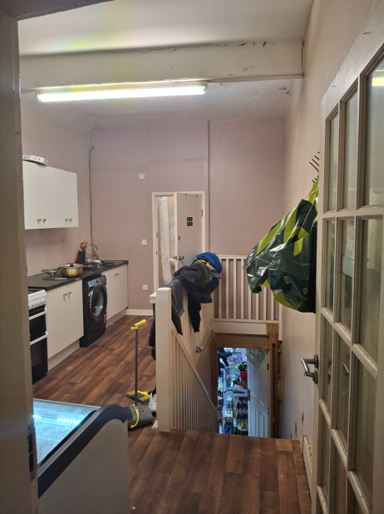
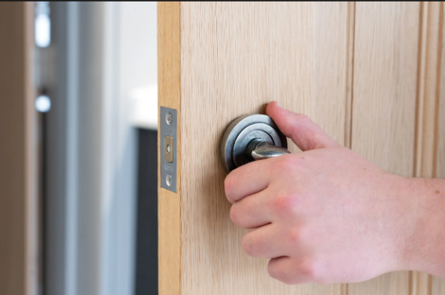

Means of Escape

Slide 22
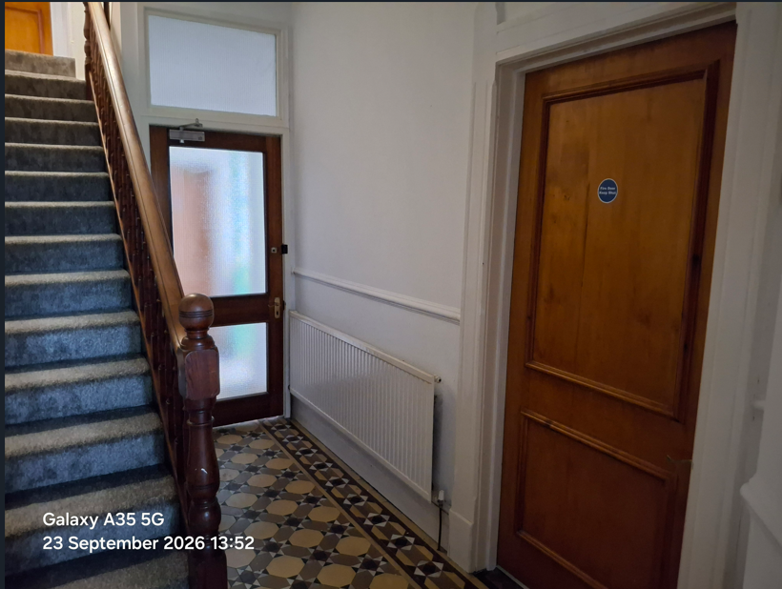
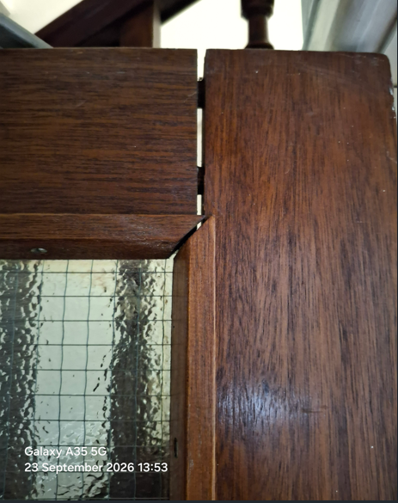
Means of escape & Fire Doors

Slide 23
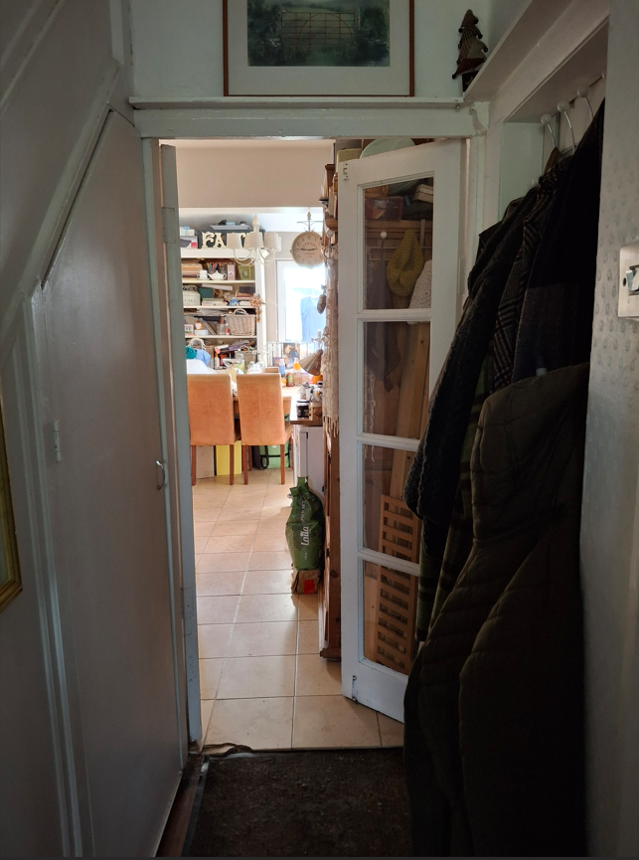
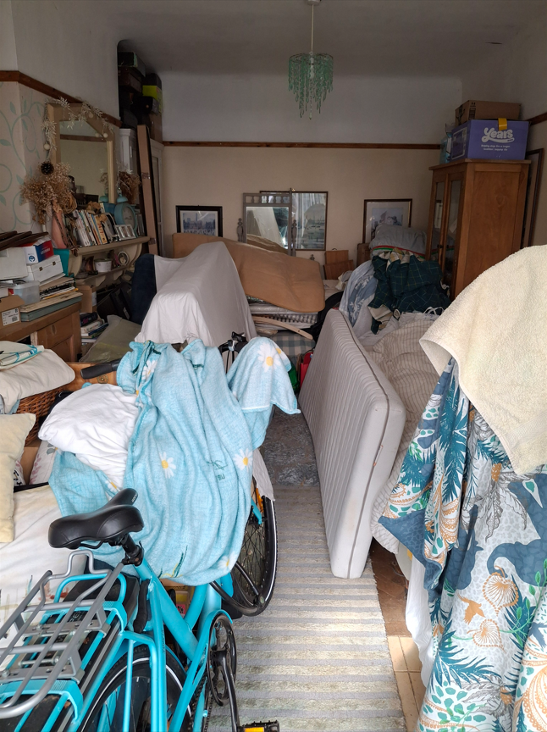

Slide 24
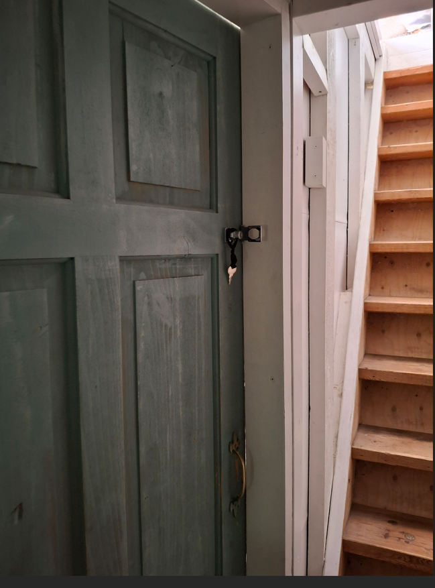
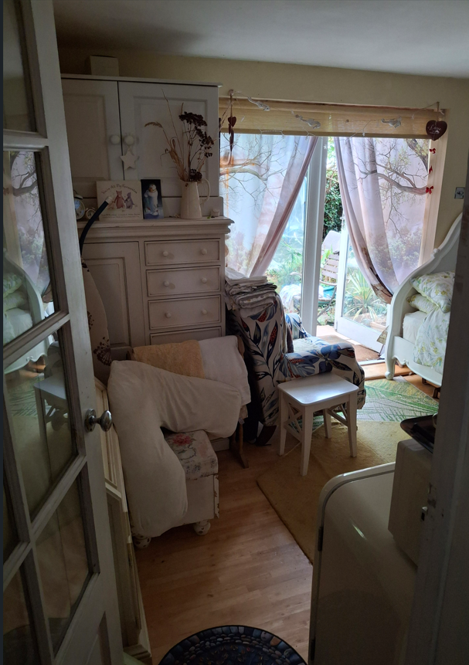
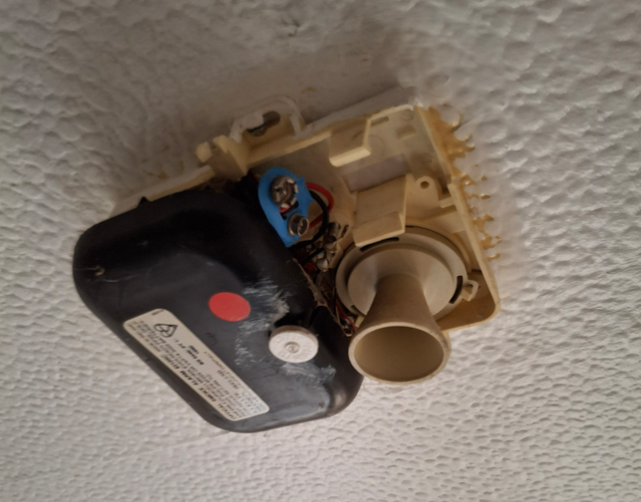

Slide 25
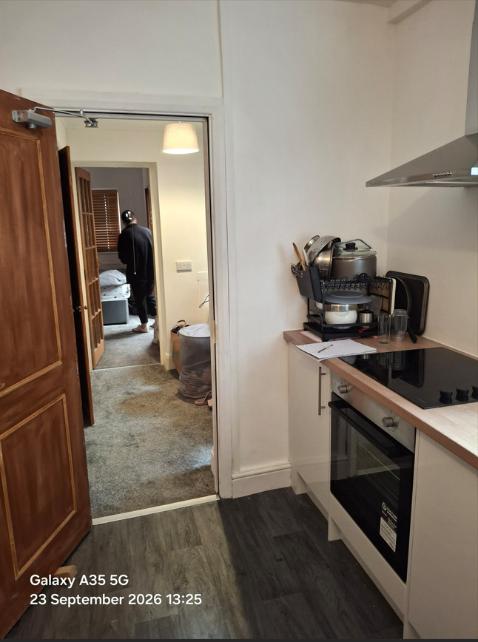
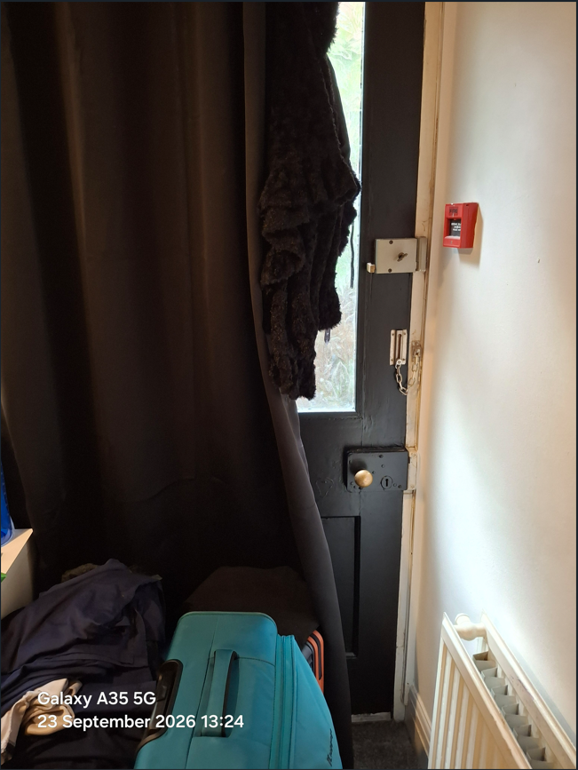
Attic and inner rooms

Slide 26
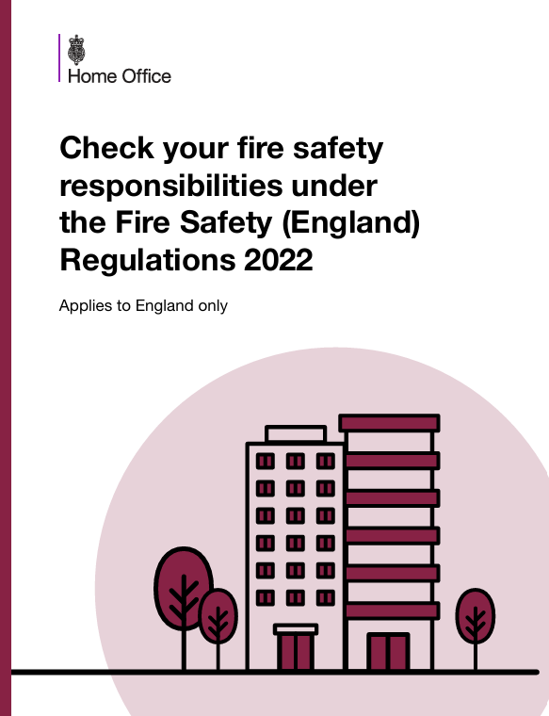
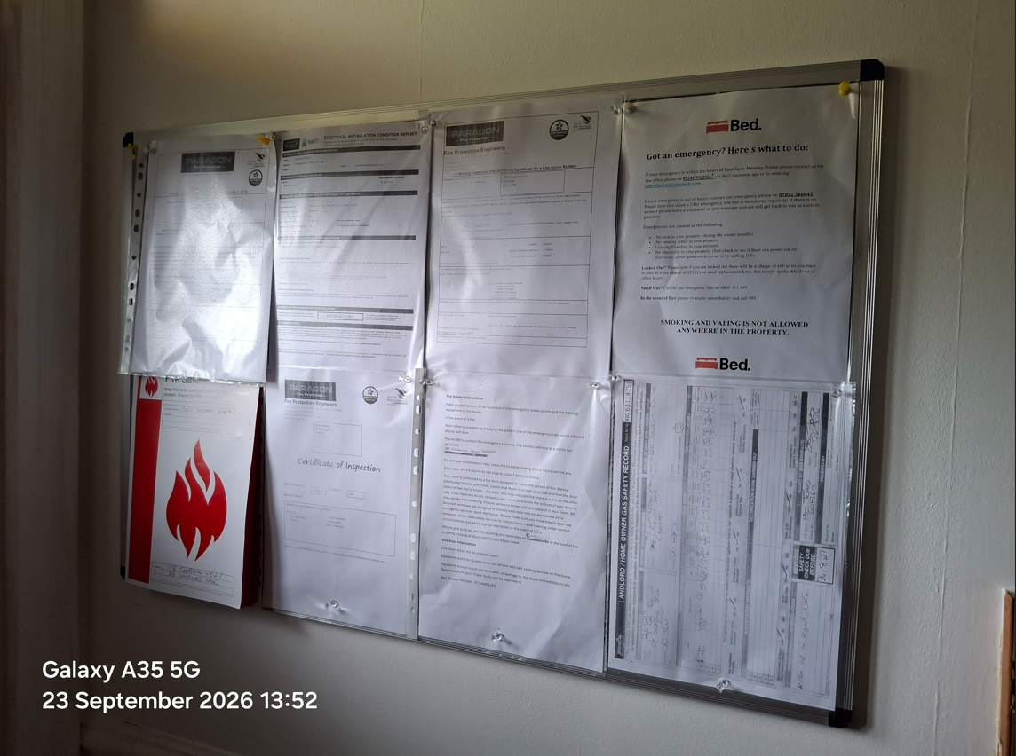
Management of fire safety
Fire Safety England Regs 2022
Common parts
Information to residents
>11m, >18m
Two or more domestic dwellings. Does not apply within flat itself
Notes:
Quarterly checks, information to residents, channels for reporting

Slide 27
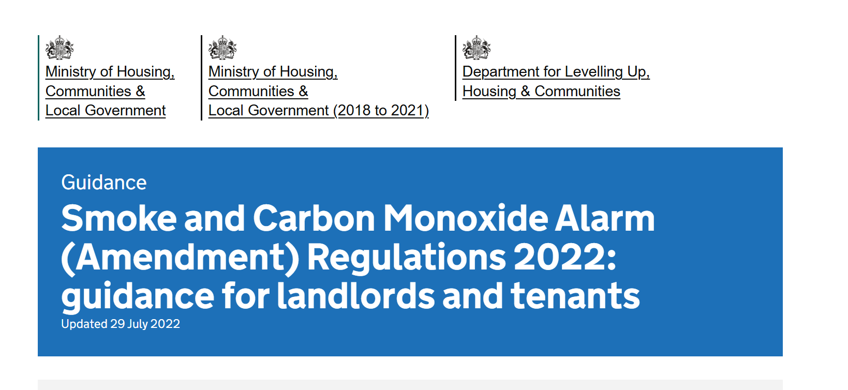
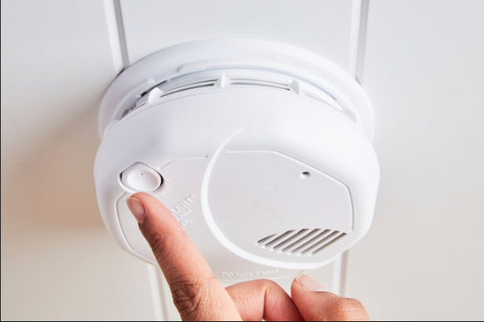
Non Fire Safety Order premises
Notes:
Part 6 interlinked detection over battery detectors

Slide 28
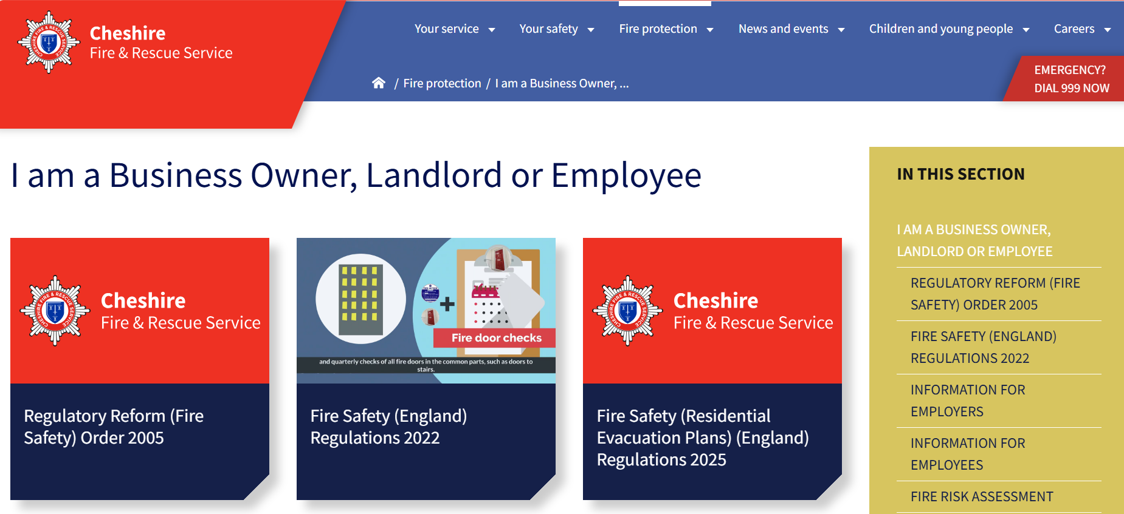
www.cheshirefire.gov.uk

Slide 29
Questions

