Slide 1


How does the future look?
Navigating changes in the private rented sector
Samantha Watkin | Senior Policy Officer

Slide 2
Renters’ Rights Act

Slide 3

Tenancy reform
Periodic assured tenancies are now the norm, can no longer offer fixed term tenancies
Rental periods limited to no more than one month.
No rent can be required before agreeing tenancy; rent in advance restricted after that (except existing tenancies).
Tenants can give two months’ notice at any time to end the tenancy.
Written statement
Key terms to be given in writing before the tenancy begins, usually as part of a wider tenancy agreement.
NRLA draft periodic tenancies available on the website
Rent increases
Rent can be increased once per year via Section 13 process, landlord has to give at least two months notice, using the appropriate prescribed form.
The tenant can challenge a proposed rent increase for £47, delaying the rent increase until the Tribunal has decided on a new rent level. Expected (Valuation Office Agency) VOA will be given power to review S13s – approx. 2 years to roll-out.

Slide 4
Advertising and discrimination
Banning bidding wars
Must list asking rent on any adverts and offers.
Banned from encouraging or accepting rents above this.
Fines of up to £7,000 for breaches.
Preventing discrimination
Bans discrimination against tenants in receipt of benefits, or with children, including when:
  Enquiring about or seeking information on the property.
  Attending viewings.
  Entering into a tenancy.
Pets in properties
Right to request a pet for tenants. Can only be refused on reasonable grounds. New rules on pets- is your property a suitable home? Under Industry News on the NRLA website
  Pets webinar held a few weeks ago for additional information

Slide 5
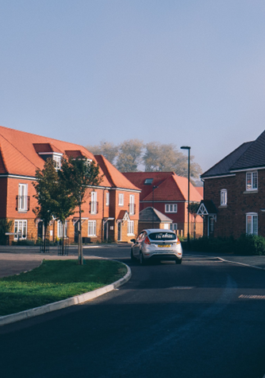
Ending a periodic tenancy
Abolition of Section 21.
New and amended Section 8 grounds including:
  Grounds for sale or moving family in
    Require four months’ notice.
    Cannot relet, or try to relet, for (probably) more than a year after serving. According to the guidance, you cannot advertise a property to relet, or physically re-let it until 12 months from either the date given in the notice or the date on which the possession claim is filed with the court. The final date will be whichever is the later of the two.
  An updated mandatory rent arrears ground.
    Three months’ arrears and four weeks' notice.
    Any Universal Credit delays don’t count as arrears.
  A new student ground.
    Only applies to student HMOs, June-September, where tenancy entered into less than six months before move-in.
New offence for recklessly or knowingly misusing a possession ground – fine of up to £7,000.
New civil penalty for illegal eviction or harassment – up to £40,000.

Slide 6

Enforcement
New fines and powers
Local authority fines of up to £7,000 or £40,000 for a host of new offences, including:
  Not joining the database, offering a fixed term tenancy, misusing a possession ground, not giving a written statement, taking rent in advance and breaching the Decent Homes Standard.
Local authorities may also enter business and rented properties without a warrant or notice for certain offences (s.113 and s.114 notices)
Investigatory powers are available for councils to use. They came into force 27th December 2025
Rent repayment orders
Rent repayment orders have been expanded to cover two years instead of one and become available for a range of new offences.

Slide 7
Enforcement – Rent repayment orders
Existing Offences
Offence | Example
Violence for securing entry | Using physical force against the tenant to enter the property
Unlawful eviction or harassment of tenants | Evicting the tenant or pressuring them to leave without following the correct legal process
Failure to comply with improvement notice | Receiving an improvement notice and not completing the required works
Failure to comply with prohibition orders, etc. | Receiving a prohibition order or similar notices and not following the instructions
Control or management of unlicensed HMO | Operating a HMO without a licence where one is required
Control or management of unlicensed property | Operating a property without a licence where one is required
Breach of banning order since 6 April 2018 | Being subject to a banning order but continuing to let property

Slide 8
New RRO Offences created by the Renters’ Rights Act
Offence | Example
Knowingly or recklessly misusing a possession ground resulting in the tenant moving out within 4 months. | The landlord includes a possession ground without a reasonable belief it would result in possession, and as a result the tenant leaves within four months of service.
Breach of restriction on letting or marketing a dwelling house | Attempting to relet or reletting in the 12 months after a Section 8 notice using Ground 1 or 1A asked for possession.
Continuing to commit a breach after receiving a financial penalty | Rent repayment orders may be sought for the period starting 28 days after the initial civil penalty while the offence is continuing
Continuing breach of the new landlord redress scheme rules, after receiving a financial penalty | Rent repayment orders may be sought for the period starting 28 days after the initial civil penalty while the offence is continuing
Providing incorrect information to the new PRS database operator | Deliberately or accidentally giving incorrect landlord contact details to the database operator
Continuing breach of the certain tenancy reform requirements | Rent repayment orders may be sought for the period starting 28 days after the initial civil penalty while the landlord is not registered on the database.

Slide 9
PRS Database/ Register Your Rental Property Service

Slide 10
Summary
Rollout of the new landlord database will begin this December
£65 per property per year to register
Compulsory for all private sector landlords in England to sign up to the new database, which is being introduced under phase two of the Renters’ Rights Act
A full timetable has now been confirmed, with a 12- month regional roll out starting in the West Midlands
You will be given a three-month window to comply with the new rules, will all landlords be registered by 14th November 2027
Awaiting confirmation of VAT status of the fee, but likely to be zero-rated.
Landlords who fail to sign up could face civil penalties of up to £7,000- rising to £40,000 for multiple or continued breaches

Slide 11
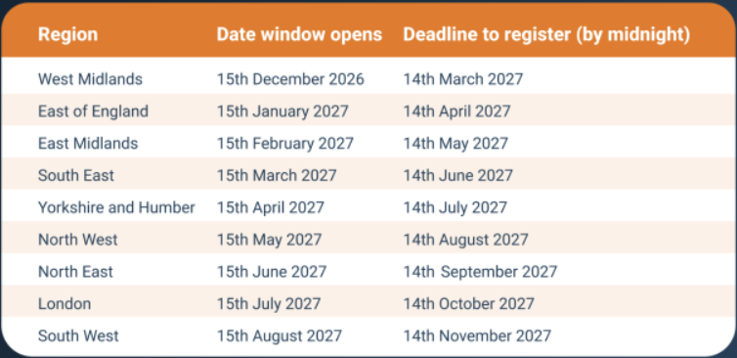
Timetable for regional rollout

Slide 12
Who needs to sign up?
Landlords of homes occupied under assured or regulated tenancies must sign up to what the Government describes as a ‘Register Your Property Service’, including all existing tenancies and any signed during the roll out period
Empty homes being marketed to let do not need to be registered at this stage- although this will change in future when you will need to provide a registration number before you can advertise your property
Agents cannot register homes on the database on your behalf, you must do this yourself- Section 4 of the Private Rented Sector Database Regulations explicitly states the landlord must register unless one of the exceptions apply. Agents are not listed as an exception to this rule, so cannot register on the landlord’s behalf
However, agents can help by providing some information on the landlord’s behalf. The Government has indicated that guidance will be published for agents and property managers on what information they can provide and how they can provide it before the registration opens
Are there any circumstances where someone else can register for the landlord?
Agents may not register for the landlord, but there are some limited exceptions where a person other than a landlord can register on the database. Personal representatives of a decreased landlord may register for example, or someone granted power of attorney.
In most other cases, the exceptions apply where the property is being repossessed or the landlord is bankrupt.
The full list of exceptions can be found in Schedule 2 of the Private Rented Sector Database Regulations 2026
Can you register properties early? Yes. Landlords can register any property from 15th December 2026 onwards, even if the regulations don’t apply to their region yet

Slide 13
How do I join the register?
It is expected you will need to join the database via the Government website- it is our understanding that each property will need to be added individually. Each landlord entry will need to include the following information depending on their ownership structure:
Individual landlord details
Name
Date of birth
Residential address
Telephone number
Email address
Company landlord details
Name of organisation/description by which it is known
Type of legal entity
Address (which cannot be a PO Box number)
Telephone number
Email address
Name, date of birth, email address and telephone number of the individual making the entry on behalf of the organisation
Name of nominated contact within the organisation for the purposes of the database, and their email address and telephone number
Companies House Registration number, if applicable
Charity number, if applicable
Where a Companies House registration number is not provided, the names, dates of birth and addresses of all directors, trustees, partners or members of the governing body of the organisation
Where the organisation is a constituted as a trust: The name, date of birth, address, email address and telephone number of the lead trustee

Slide 14
Further FAQs
Is the fee payable every year?
Yes. The fee of £65 is paid on renewal each year for each property. The payment must be made on or before the anniversary of the registration of the first property in the landlord’s portfolio.
For landlords with multiple properties, the Government have confirmed that the renewal date will be the date on which the first property was registered, meaning the whole portfolio will have the same renewal date.
Properties that are registered later- because they are in a different region for example, would pay a prorata amount of the fee for the first year.
Will new gas or electrical safety certificates need to be uploaded when the last one expires?
Yes. When the required information for the entry changes, landlords must update the record within 28 days of the change occurring.
Will there be an option to bulk upload documents and registration information?
Once registration opens, we understand that there will be no option to register multiple properties at once or provide bulk uploads of property information.
Landlords with larger portfolios should bear this in mind and begin registration early to allow enough time to complete registration of all their properties prior to the deadline
Will I need to register if I already have a selective, additional or mandatory HMO licence?
Yes. You will need to register with the database and hold a licence as this database is separate to any licensing requirements that apply to your property.
The NRLA has raised concerns with the Government about the increased administrative burden and the cost of registering for both. We have also questioned the need for selective licensing schemes once the database is implemented, as local authorities will already have access to the database’s information.

Slide 15
Enforcement of the database requirements
Failing to register with the database will have serious consequences. The Renters’ Rights Act gives local authorities powers to enforce the database requirements through fines, and also prevents landlords from obtaining possession if they have not registered
Civil penalty offences: Section 82 of the RRA creates civil penalty offences for-
Marketing a property for let without an active landlord and property entry on the database
Not including the unique landlord and property reference number in any adverts
Failing to update the database record after it changes
These offences carry a maximum civil penalty of up to £7,000
Section 92 of the Renters’ Rights Act also makes it an offence to-
Knowingly or recklessly provide false or misleading information to the database or
Continuing to breach the database requirements after being convicted of, or receiving a civil penalty for, a breach of Section 82 of the Renters’ Rights Act. This occurs where the landlord commits another offence within five years or does not stop the behaviour within 28 days of the initial penalty
Local authorities may issue a civil penalty of up to £40,000 where this occurs
Rent Repayment Orders: Section 98 of the RRA allows tenants to also apply for a Rent Repayment Oder where the landlord has knowingly or recklessly provided false information to the database or not registered on the database within 28 days of receiving a civil penalty or conviction
Restrictions on regaining possession: Unless possession is being sought on the grounds of anti-social behaviour, Section 90 of the RRA prevents a court from granting possession orders while the landlord does not have both an active landlord entry and an active dwelling entry in the database

Slide 16

Webinar- Renters’ Rights Q&A- Registering on the database. 1st October
Join our Head of Compliance, James Wood, and other experts to ensure you are on top of the changes.
The presentation will be followed by a live Q&A. If you’d like to submit any questions in advance, please email campaigns@nrla.org.uk
The webinar is for NRLA Members and Associates only.

Slide 17
VOA/Rent increase determination
Announcement in early September by the Government on plans to change the way challenges to rent increases will be dealt with in England
HMRC’s Valuation Office Agency (VOA) will take over responsibility for initial rent determinations from the First-Tier Tribunal
Under proposed changes- when a tenant challenges a proposed rent increase, the VOA will initially determine the appropriate rent rather than the case going directly to the Tribunal in the first instance
This change will require secondary legislation and implementation, expected to take around two years before it comes into force
For now- landlords should continue to use the current system

Slide 18
Key dates: phase 2
Spring/Summer 2026
Financial Penalties for Category 1 Hazards (following publication of updated guidance).
From 15 December 2026
PRS database roll-out begins – starting in the West Midlands
2028
Expected date for mandatory sign-up to the PRS Landlord Ombudsman.
31 July 2026
Deadline for applications to court for possession under Section 21.
April 2027
Government expects end-to-end digitisation of the courts.
www.nrla.org.uk

Slide 19
Standards
Decent Homes Standard
New standard will require “reasonably modern facilities” and homes in a “reasonable state of repair.” Not expected to apply before 2035.
Awaab’s Law
Address damp and mould issues within set timeframes, as well as new standards on emergency repairs. Pending consultation. Already rolled out for social landlords since October 2025 and requires social landlords to address emergency hazards within 24 hours, investigate significant damp and mould hazards within 10 working days and make the property safe within 5 working days. This framework might form a blueprint for the consultation for the PRS.
Ombudsman
New Ombudsman introduced under RRA. Sign up to the new Ombudsman, for a fee, before a property is let
All private landlords in England will be legally required to join, regardless of portfolio size and how the property managed i.e. self managed or via a letting agent
The Ombudsman will deal with disputes and will require secondary legislation. Will have powers to compel landlords to issue an apology, provide information, taken remedial action, and/or pay compensation to tenants. Ombudsman – Expected 2028
Who will run it?- No final decision confirmed, but likely to be the existing Housing Ombudsman Service (who currently deals with social sector complaints).

Slide 20
Other Key Dates
Date | Milestone
²⁰²⁷ | Renters’ Rights Act reforms introduced into the social rented sector
May 2028 | Government to publish an initial evaluation of the Renters’ Rights Act’s impact.
May 2031 | Government to publish a second evaluation of the act at the five-year mark
? | Awaab’s law to be introduced to the PRS – we don’t know yet and are waiting for a consultation.
2035/2037 (?) | Suggested dates for the Decent Homes Standard to be introduced as put forward in the consultation that ran earlier this year. Not confirmed yet and some parts may be brought in sooner.

Slide 21
Done!

