Slide 1
2021 Census
Lee Huxley
Demographic Analyst
Insight and Intelligence Team, Cheshire West and Chester Council
Lee.Huxley@cheshirewestandchester.gov.uk

Slide 2
Background
Rich, detailed picture - population and society at a point in time
Helps inform planning and funding of services
Small geographies (e.g. parishes)
Run by Office for National Statistics (ONS)
Census day - 21 March 2021
98% response in CW&C (97% Eng&W, 90% responded online)
Main results now available Census 2021 - ONS release plans

Slide 3
Increase in older people (65+)
Population and households in Cheshire West and Chester
357,200 population - increase of 8.4% (27,600) since 2011 Census (6.3% in Eng&W).
155,200 households (141,400 (2011 Census))
Males
Females
24.2% (14,800) more people aged 65+ than in 2011
(20.0% increase in Eng&W)
75,900 people aged 65+ in 2021 (61,100 in 2011)
Older age structure in CW&C than England & Wales.
Source: 2021 Census. Office for National Statistics. Contains public sector information licensed under the Open Government Licence v3.0.

Slide 4
Topic summaries (Univariate data (one variable only) and published down to Output Area (OA) level (small areas with around 300 people), where possible)
Demography - 30.2% (46,889) of households are people who live alone (30.2% in Eng&W), 21,284 of these are lone pensioner households (aged 66+).
Veterans - 4.5% (13,354) of usual residents (16+) said they had previously served in the UK armed forces (3.8% in Eng&W).
Ethnicity, language and religion - 8.8% (31,529) of usual residents were from minority ethnic groups (including White groups; Irish, Gypsy or Irish Traveller, Roma and Other) (5.3% (17,595) in 2011). 25.6% in Eng&W.
Labour supply and travel to work - 31.5% (53,184) of usual residents aged 16+ and in employment the week before the Census worked mainly from home (31.2% in Eng&W).
Sexual orientation and gender identity (voluntary 16+) - 2.8% (8,313) identified with an LGB+ orientation (Gay or Lesbian, Bisexual or Other sexual orientation)
Housing - More households renting, 30.4% (47,094) than in 2011 (27.2%)
Education - 35.7% (105,387) of usual residents aged 16+ had level 4 qualification (degree or equivalent) (33.8% in Eng&W)
Health, disability and unpaid carers - 17.9% of residents were disabled (Disabled under the Equality Act) (18.8% in 2011) (17.8% in Eng&W)
Source: 2011 Census, 2021 Census. Office for National Statistics. Contains public sector information licensed under the Open Government Licence v3.0.

Slide 5
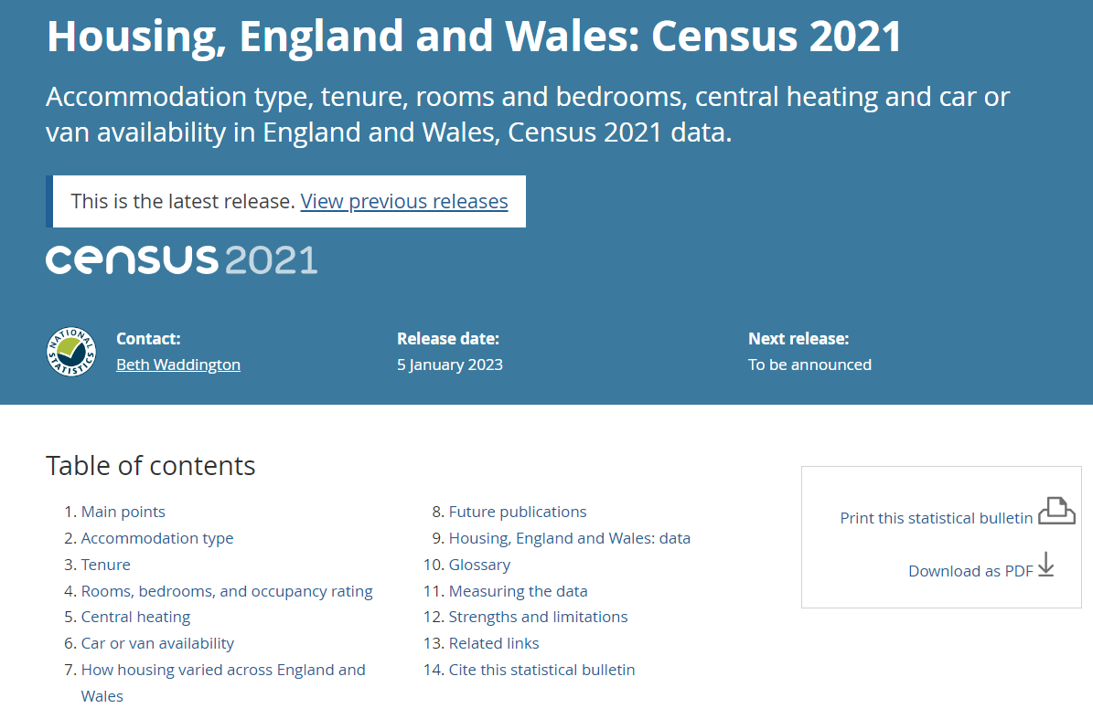
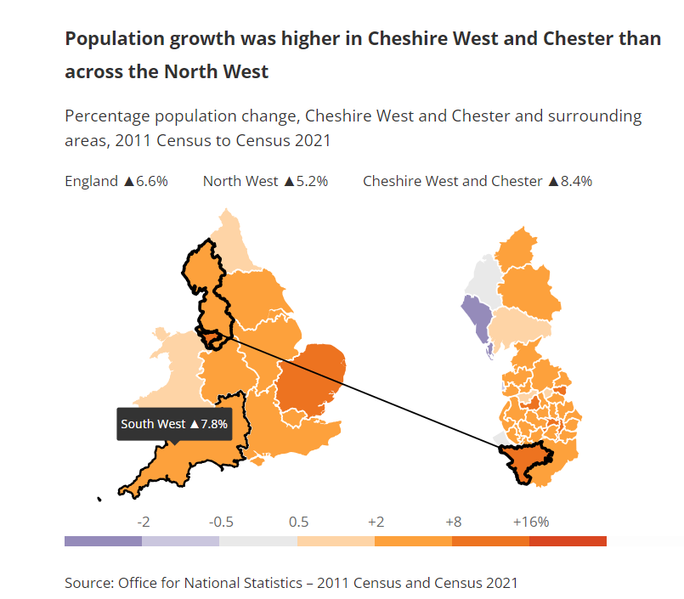
ONS data and tools Where to access data…
NOMIS – census data
Topic summaries – ONS (data, commentary)
How your local authority has changed in 10 years: Census 2021
Plus a scrollytelling article: Cheshire West and Chester population change, Census 2021 – ONS

Slide 6
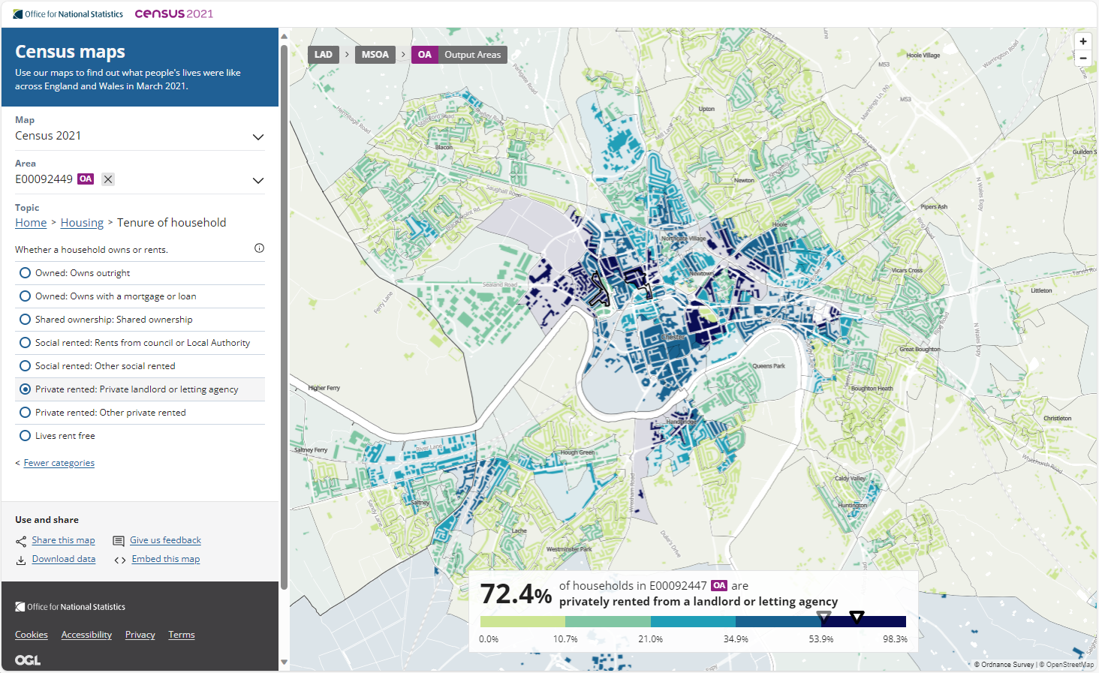
ONS data and tools
Census Maps - Census 2021 data interactive, ONS

Slide 7
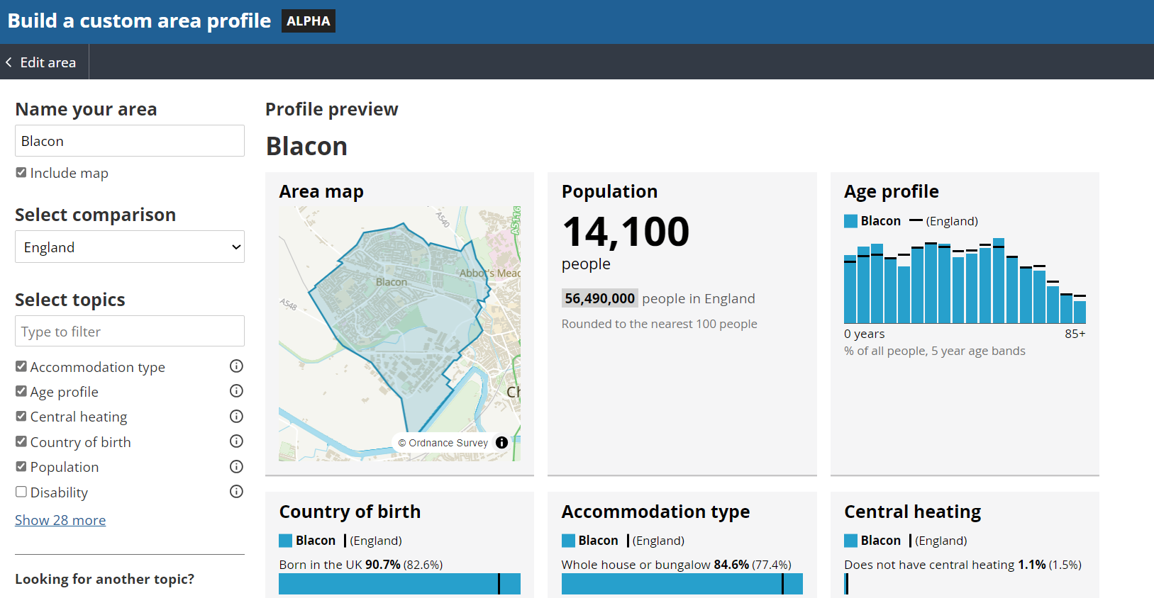
ONS data and tools
Build a custom census area profile, ONS

Slide 8
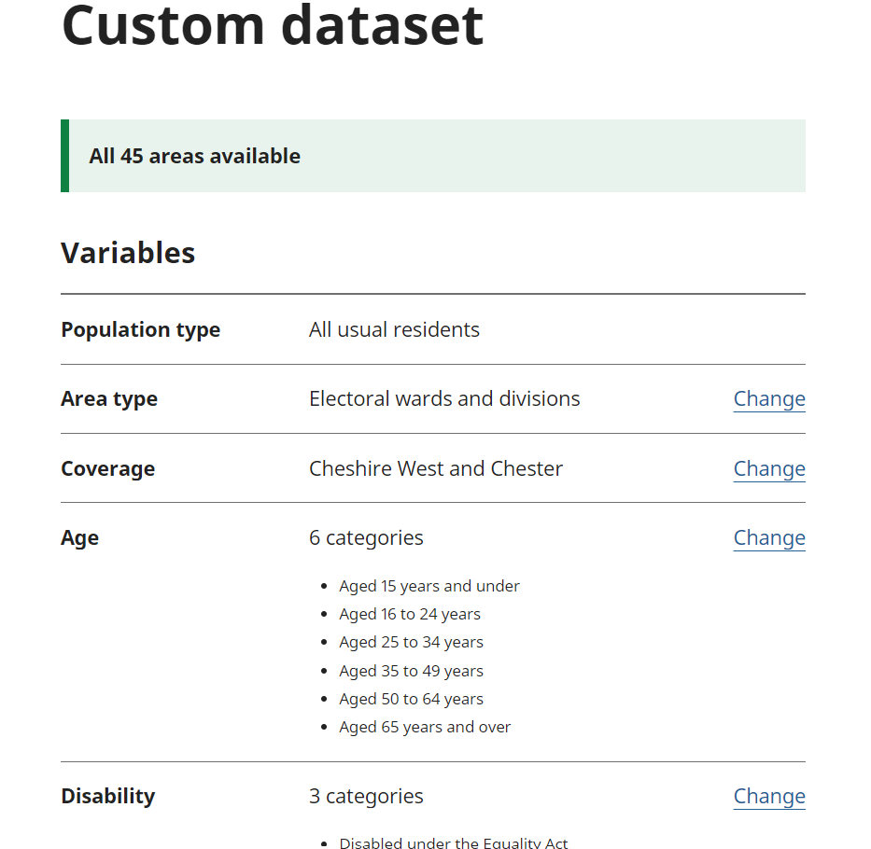
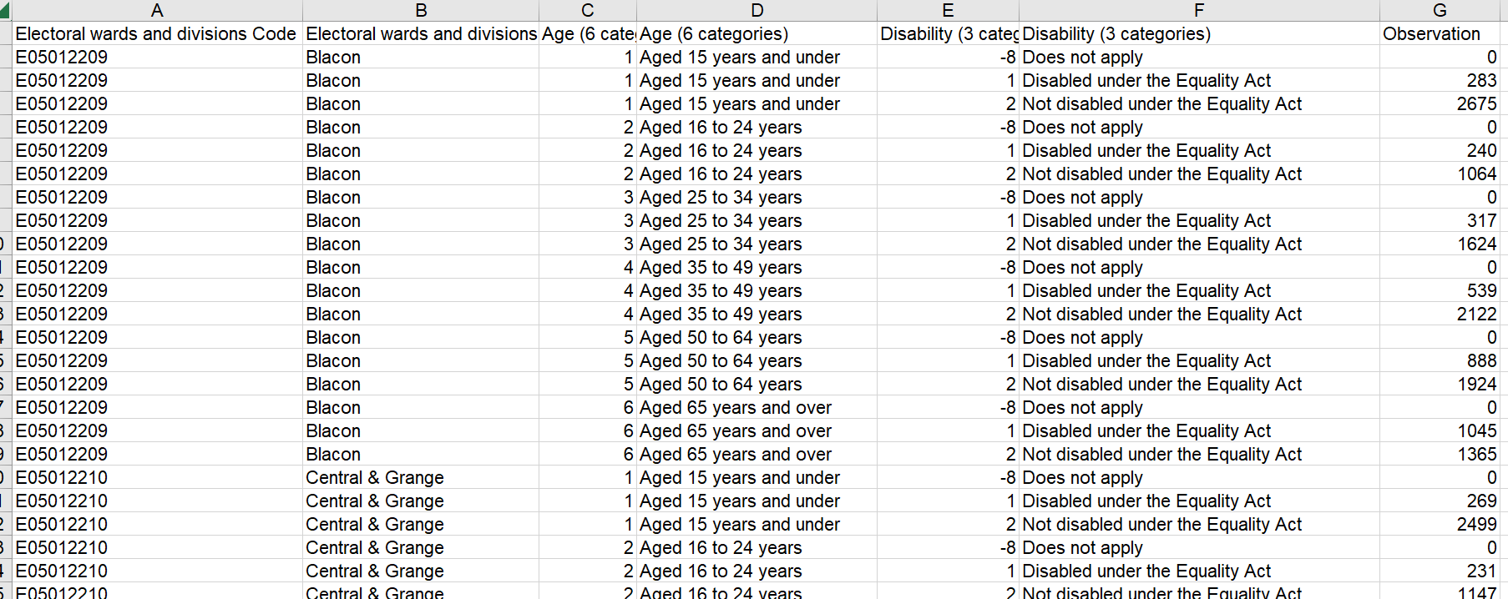
ONS data and tools
Create a custom census dataset, ONS
For more information on any of these tools: Census 2021 interactive content - Census 2021

Slide 9
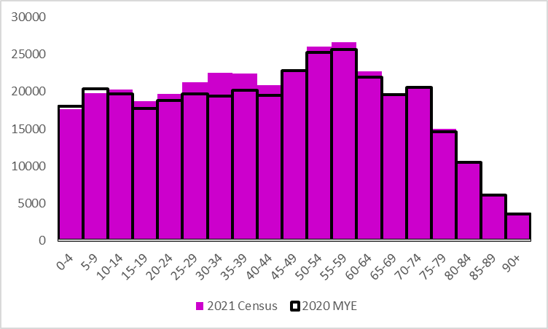
Impact on population estimates
2021 Census day population estimate (357,200) is 3.9% (13,400) higher than the mid-2020 estimate (343,800).
Key difference is 25-44 age group - 10.6% (8,400) more people (2021 Census) than mid-2020 estimate.
Why is this important?
Funding, unemployment rates, fertility rates, life expectancy, benefit take up, COVID rates ...
Differences will be larger for some smaller geographies
ONS are working to revise all their previous population estimates from 2012 to 2020
Be aware:
Impact on trendlines, period of flux
Statistical disclosure control, record swapping, small changes to some cells in some tables, statistics in different tables may not match
Output area geographies changed in 2021
COVID – furlough, working from home, view of ‘general health’

Slide 10
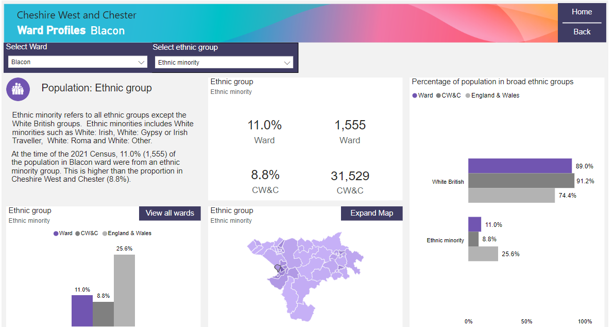
JSNA products
Cheshire West and Chester Council - Census 2021
2021 Census first results bulletin (June 2022)
State of borough
Ward profiles
For further information or help accessing 2021 Census results : research@cheshirewestandchester.gov.uk

