Slide 1
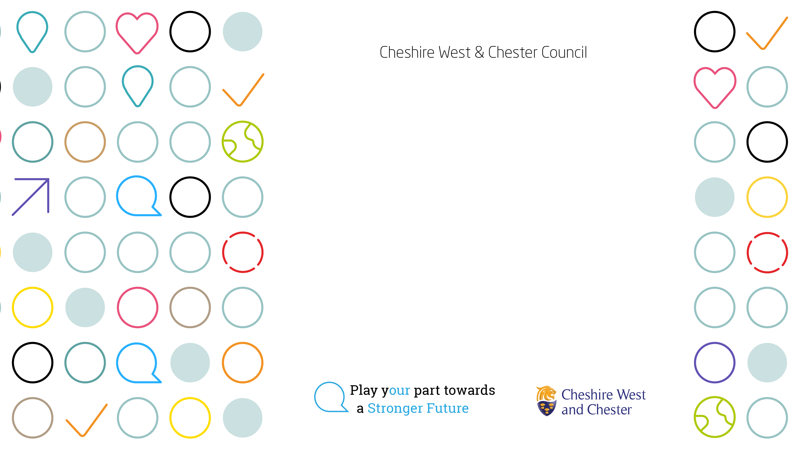
Updated Housing Health and Safety Rating System
September 2026

Slide 2
What is the Housing Health and Safety Rating System?
The HHSRS is a risk assessment tool which councils use to decide whether a home is safe and healthy to live in. It was introduced by Part 2 of the Housing Act 2004, which came into force in 2006, and applies to all rental property in England.
It was a complex risk-assessment system used by local councils to identify 29 separate potential hazards, and scoring them using bands A to J, with A being the most dangerous and life-threatening.
A council officer inspects a property, identifies hazards that may threaten the health or safety of people living in an individual property, and generates a numerical score to show the overall risk the hazard poses.

Slide 3
What is a hazard?
Section 2 of the Housing Act 2004 defines a hazard as:
“any risk of harm to the health or safety of an actual or potential occupier of a dwelling or HMO which arises from a deficiency in the dwelling or HMO or in any building or land in the vicinity (whether the deficiency arises as a result of the construction of any building, an absence of maintenance or repair, or otherwise)”.
There are two categories as follows:
A Category 1 hazard is a serious hazard that scores between A (over 5,000) to C (over 1,000) under the rules until June 2026. From 23 June 2026, a Category 1 hazard will be one that scores as “High”. With Category 1 hazards, the council has a legal duty to take action.
If a hazard scores under 1,000, but still gives cause for concern, it is deemed a “Category 2 hazard”. In this case, the council has the discretion to take action to reduce the risk to health from that hazard.

Slide 4
What has changed?
There are five new changes which come in from 23 June 2026 as follows:
The 29 hazards are now 21 hazards - 29 hazards under the previous system have been reduced to a range of 21 hazards that may “threaten the health or safety of occupiers in an individual residential dwelling”.
Bands A to J are now High, Medium and Low - Previously, hazard scores were classified under 10 bands (A to J), which meant very little to landlords or tenants. The new system has three bands: High (score 1,000+), Medium (100-999), and Low (under 100).
New names for the 4 classes of harm – Extreme, Severe, Serious and Moderate. The new 4 classes of harm and illustrative examples are detailed in revised guidance: The Housing Health and Safety Rating System (HHSRS): Operating Guidance (Part 1): An Introductory Guide
The definition of “prescribed fire hazard” has been broadened – to include: exposure to uncontrolled fire and associated smoke and fumes, an explosion, or the collapse of the whole or part of a building as a result of fire or an explosion.
Introduction of baseline indicators - designed to address common health related housing deficiencies and designed to be applied to “most property types and ages”. Examples of indicators include: Heating, Damp, Stairs, Windows above ground level and smoke and heat detectors.

Slide 5
What are the new hazards?
Protection against accidents
Falls on the level
Falling on stairs etc
Falling between levels
Fire and explosions
Flames, hot surfaces etc
Collisions, entrapment and ergonomics
Structural collapse and falling elements
Electrical hazards
Physiological requirements
Excess cold
Radiation
Damp and mould growth
Lead
Indoor air pollutants
Excess heat
Asbestos and manufactured mineral fibres
Protection against infection
Domestic hygiene
Water supply
Psychological requirements
Crowding and space
Entry by intruders
Noise
Lighting

